Slide 1


PENETRATION TESTING TOOLS &TECHNIQUES

Slide 2

1 WHAT IS PENETRATION TESTING
2 PHASES OF PENETRATION TESTING
3 PENETRATION TESTING TYPES
4 PENETRATION TESTING TOOLS
5 METASPLOIT

Slide 3
WHAT IS PENETRATION TESTING ?
Penetration testing is an attempt to exploit the vulnerabilities to determine whether unauthorized access or other malicious activity is possible

Slide 4
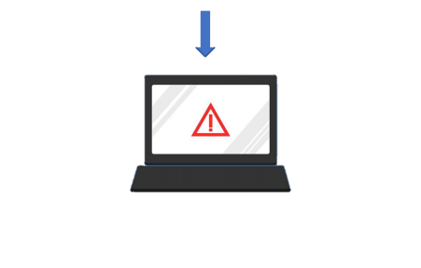
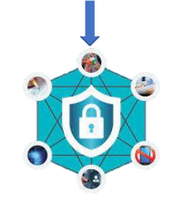

WHAT IS PENETRATION TESTING ?
Penetration testing is an attempt to exploit the vulnerabilities to determine whether unauthorized access or other malicious activity is possible
Purpose
Discover Test For Security Compliance Verify Staff Awareness

Slide 5

SYSTEM COMPLEXITY
INSECURE NETWORK
POOR SYSTEM CONFIGURATION
DESIGN & IMPLEMENTATION
HUMAN ERRORS

Slide 6

PHASES OF
PENETRATION
TESTING

Slide 7




INFORMATION GATHERING & RECONNAISSANCE
SCANNING
EXPLOITATION
RISK ANALYSIS
GENERATE REPORT

Slide 8

INFORMATION GATHERING & RECONNAISSANCE
Attacker gather as much information about the target as Possible
Set Goals & scope
Info Gathering intelligence
Decide what type of method use to testing
Example :- Ip Address , Mac Address , Domain Details , Mail Server , Network Topology

Slide 9



SCANNING
Attackerscan all things and aim to identify the loopholes or the weak points which are present in a System and a Network or a Applications
Static Analysis
Dynamic Analysis
Inspecting Application code logic , Functions , etc
Inspecting Application code in running state.

Slide 10

EXPLOITATION
This is execution phase where actual damage is done
It's required Special skills & technique to launch a attack on target system .
Using this techniques
An Attacker try to get Data
Compromise the System
Launch the Dos and Ddos attack
To check how System was Compromise .

Slide 11

RISK ANALYSIS
Collecting Information of exploited Vulnerabilities
Collect the Evidence
Categorize the risks to :-
. Critical
. High
. Medium
. Low
. Info
Reporting results to executive management

Slide 12





GENERATE REPORT
In this Step the result of Penetration tester Compile into the detail report
Summary of intire Penetration testing in the report .

Slide 13
TYPES OF
PENETRATION TESTING

Slide 14
TYPES OF PENETRATION TESTING
01. | Wireless
Web Application
03.
Social
Engineering
05.
02
Network
04.
Client Side
.

Slide 15

WHITE BOX
FULL KNOWLEDGE
GRAY BOX
SOME KNOWLEDGE
BLACK BOX
NILL KNOWLEDGE

Slide 16

PENETRATION
TESTING
TOOLS

Slide 17

PENETRATION TESTING TOOLS
Why we need this types of Tools
Save Time and Effort
Advance Results
Gather Bulk Data
Automate Manual Task

Slide 18





POPULAR PENETRATION TESTING TOOLS

Slide 19
PENETRATION TESTING TECHNIQUES

Slide 20
PENETERATION TESTING TECHNIQUES
EXTERNAL TESTING
INTERNAL TESTING
BLIND TESTING
DOUBLE BLIND TESTING
TARGETED TESTING

